Slide 1
Aircraft Risk Analysis
Determining Low Risk Aircraft Operations to Invest in

Slide 2

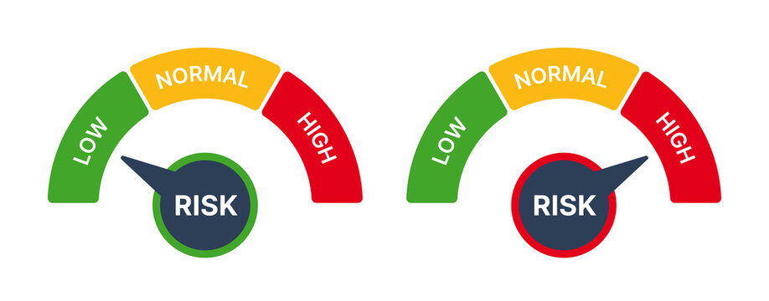
Business Overview
Our Company’s expansion plan looks to invest into the aviation industry
This projects seeks to assess risk potential from analysis of aviation accident data from 1962 to 2023
This should provide useful insight into which aircrafts to purchase to minimize operational risks

Slide 3
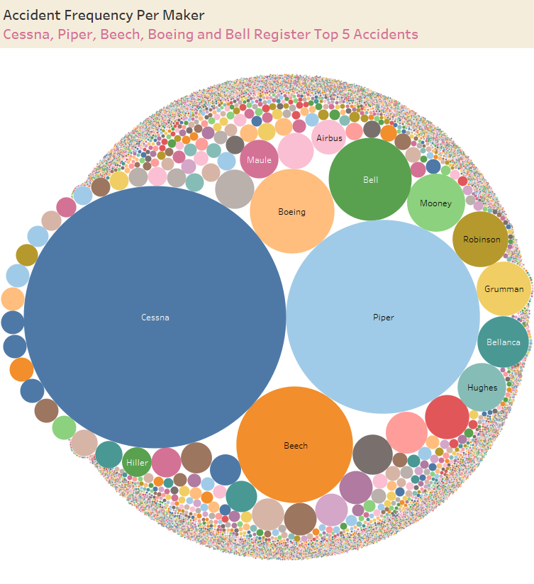
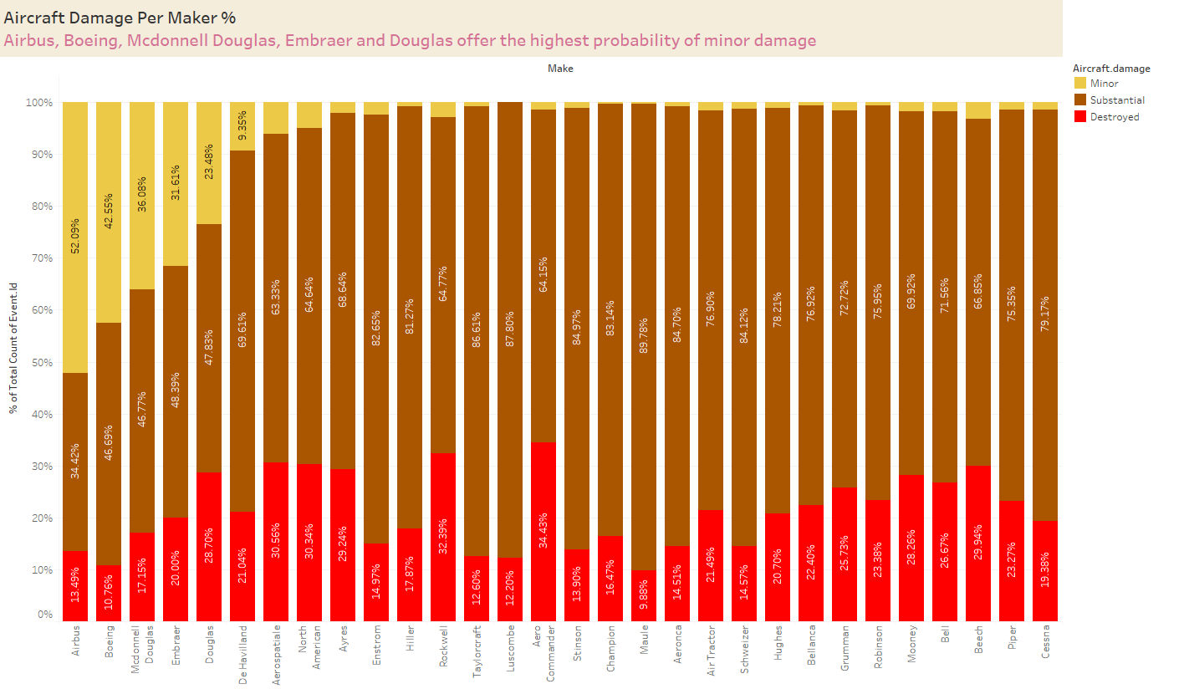
Observed insights from the accident data
It is important to consider the probability of accidents per manufacturer
Cessna registers highest accident rate
It is also important to consider the severity of aircraft damage in the event of an accident
Airbus and Boeing register the lowest probability of substantial-to-total damage in the event of an accident

Slide 4
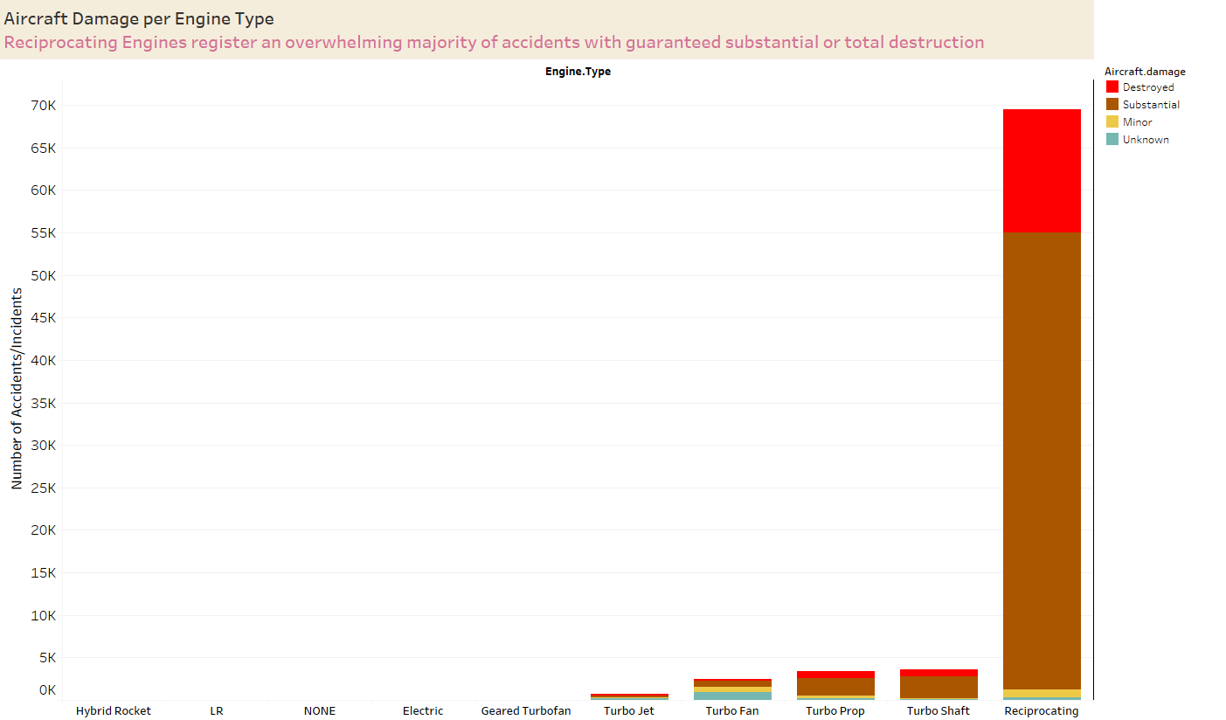
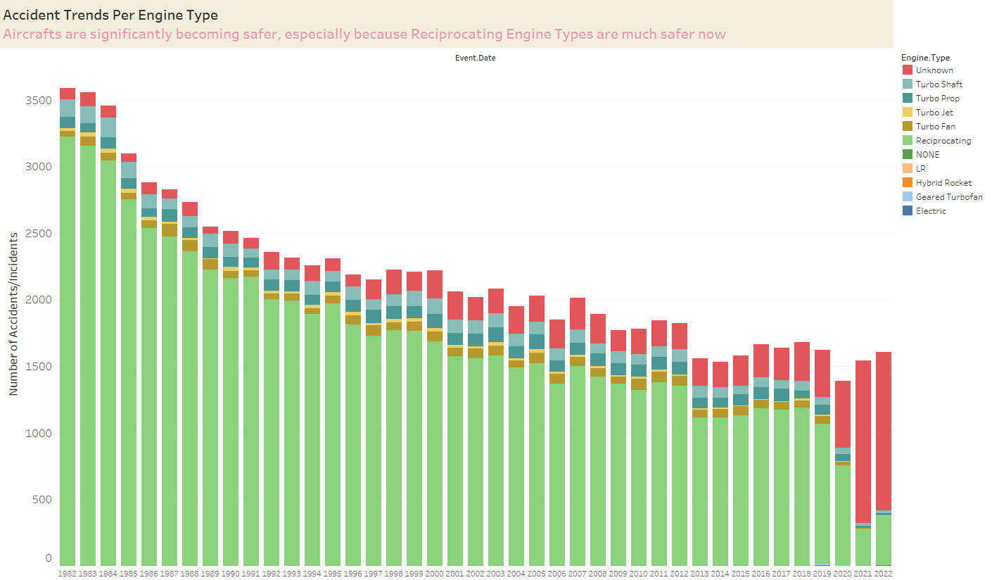
Observed insights from the accident data
It is important to consider the probability of accidents per engine Type
Reciprocating Engine Aircrafts yield the highest number of accidents
However, the number of accidents has steadily declined over the years, more-so in parallel with the decline of reciprocating engines
Is this because reciprocating engines have gotten safer?
Or is this because reciprocating engines are not being used as much today??
Another study required to verify this point

Slide 5
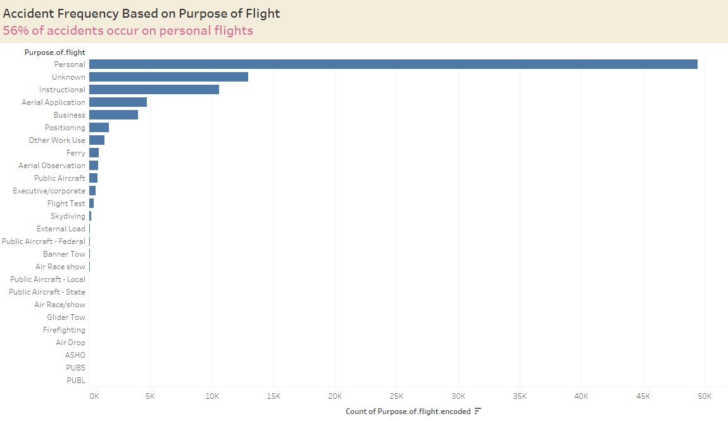
Observed insights from the accident data
Personal flights yield the highest number of accidents
This is a high risk venture that the company should steer off from

Slide 6
Conclusions & Recommendations
More studies required to put the accident insights in correct context with respect to the total population of aircrafts in operation for those years
The risk associated with operating aircrafts for personal flights is too high
The company should avoid a venture dealing in personal flights
For high occupancy operations, Airbus and Boeing appear to show lower risk of substantial/total destruction of the plane in the event of an accident

